Slide 1


Day Time Break
Activity 1: Mental Health Myths & Facts

Slide 2
Mental health is an important topic. If you’re physically hurt or ill, it can be obvious and easy to see — and easier to describe in words. But because we can’t always tell what someone is thinking and feeling, mental health can be harder to understand and talk about.

Slide 3
What does “mental health” mean?

Slide 4


What does “mental health” mean?
Mental health includes how we think, feel, and act. It also helps guide how we handle stress, relate to other people, and make decisions.

Slide 5
What does it mean to have a mental health diagnosis?

Slide 6

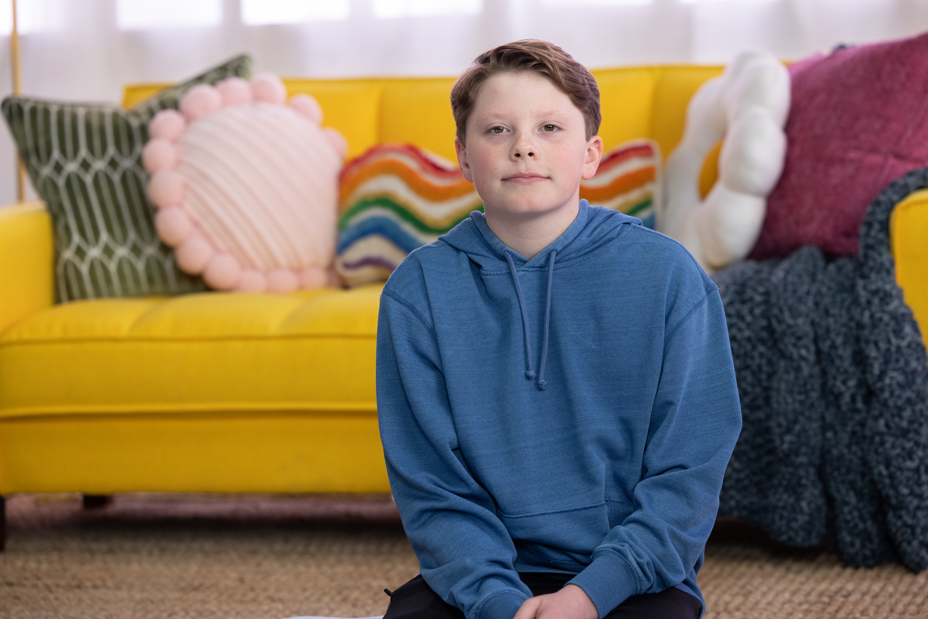
What does it mean to have a mental health diagnosis?
When our thoughts, feelings or behaviors feel out of our control for most days of the week, multiple weeks at a time, and start to get in the way of our daily lives. This can also include difficulty focusing, controlling our emotions or learning.

Slide 7
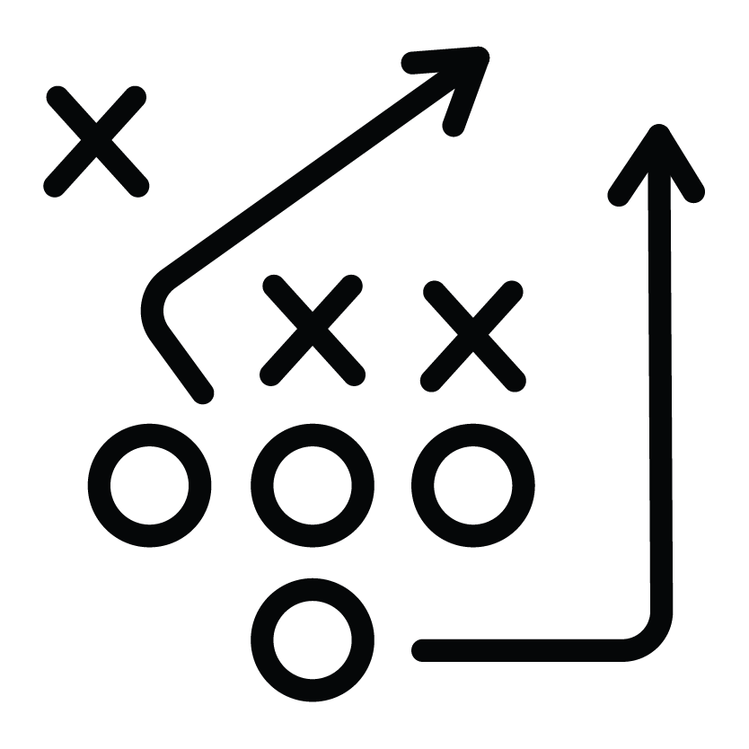

True or False?
Keeping your brain in shape is just as important as physical fitness.

Slide 8
True or False?
Keeping your brain in shape is just as important as physical fitness.
TRUE

Slide 9


True or False?
Kids don’t have mental health challenges.

Slide 10
True or False?
Kids don’t have mental health challenges.
FALSE

Slide 11


True or False?
You can get a diagnosis for a mental health disorder online (TikTok, YouTube, etc.).

Slide 12
True or False?
You can get a diagnosis for a mental health disorder online (TikTok, YouTube, etc.).
FALSE

Slide 13


True or False?
Friends and family can make a big difference in supporting each other’s mental health.

Slide 14
True or False?
Friends and family can make a big difference in supporting each other’s mental health.
TRUE

Slide 15


True or False?
Kids who have lots of friends, get good grades, and have lots of talents are happy.

Slide 16
True or False?
Kids who have lots of friends, get good grades, and have lots of talents are happy.
FALSE

Slide 17
Mental Health Myths & Facts
Part 2: Match each mental health or wellness term to its definition
MENTAL HEALTH TERMS | DEFINITIONS
1. “good” stress | A. Feeling really overwhelmed for a long time because you think you can't handle something tough. Can make us feel sick, sad or tired, and it can make life less fun and happy.
2. self-care | B. Pressure or stress we feel during challenging occasions or tasks (like playing a sport or singing in a concert) that motivates us to prepare and perform.
3. “bad” stress | C. This practice involves thinking and talking about things you are thankful for. Building this habit can help boost your mood and remind you of the good things in your life.
4. protective factors | D. Behavior that decreases the risk of mental illness, reduces the effects of worrying or improves mental health.
5. gratitude | E. Behaviors that include eating healthy, getting good sleep, moving a little bit every day and creating positive relationships with family and friends to help keep the mind fit and healthy.

Slide 18
Mental Health Myths & Facts
Part 2: Match each mental health or wellness term to its definition
MENTAL HEALTH TERMS | DEFINITIONS
1. “good” stress | A. Feeling really overwhelmed for a long time because you think you can't handle something tough. Can make us feel sick, sad or tired, and it can make life less fun and happy.
2. self-care | B. Pressure or stress we feel during challenging occasions or tasks (like playing a sport or singing in a concert) that motivates us to prepare and perform.
3. “bad” stress | C. This practice involves thinking and talking about things you are thankful for. Building this habit can help boost your mood and remind you of the good things in your life.
4. protective factors | D. Behavior that decreases the risk of mental illness, reduces the effects of worrying or improves mental health.
5. gratitude | E. Behaviors that include eating healthy, getting good sleep, moving a little bit every day and creating positive relationships with family and friends to help keep the mind fit and healthy.
B
E
A
D
C

Slide 19
Mental Health Myths & Facts
Part 3: Take a Day Time Break! Just as you practice a sport or activity to get better at it, you can also practice improving your mental health. One way to do that is by thinking about things that make you feel good and that you’re thankful for.
Draw something that you’re grateful for or something that symbolizes it. Ask yourself this question as you draw: What am I grateful and thankful for?

Slide 20
Day Time Break
Activity 2: Take Care

Slide 21
We all feel stressed sometimes. Some stress is normal. Too much stress isn’t good for you, so it’s important to know how to take care of yourself and manage the stress you feel.

Slide 22

How do you deal with feelings of worry?
What do you do to make yourself feel better when stressed?

Slide 23



Ways to Make Yourself Feel Better
Talk with a parent or another trusted adult about your feelings.
Take deep breaths: inhale for 4 seconds, hold for 4, exhale for 4, hold for 4 and repeat.
Play your favorite music and sing along.
Write in a journal or draw/sketch.
Close your eyes and imagine visiting your favorite place.
Call or text a friend.

Slide 24
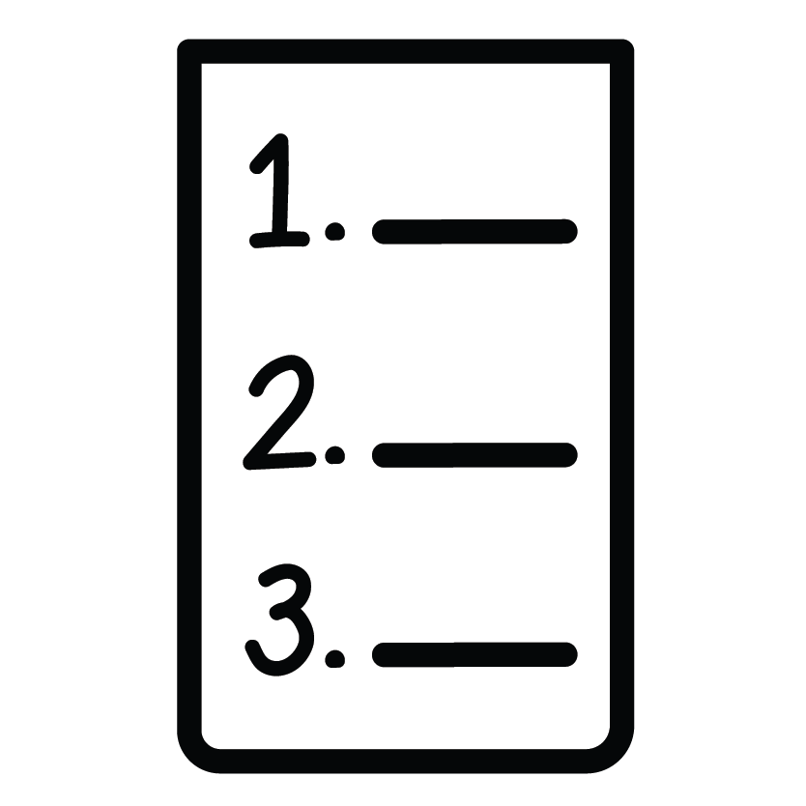


Ways to Make Yourself Feel Better
Break down tasks into smaller, easier steps.
Go for a walk, exercise or dance.
Laugh — watch a funny video, tell jokes, look at silly memes or GIFs.
Do a “body scan” where you slowly relax from your head to your toes.
Get enough sleep and eat healthy foods.

Slide 25
Take Care
Part 1: Choose healthy coping strategies from the previous list, or add your own, that you want to use when you are feeling stressed. Pick at least one strategy for each category below: to help you connect with others, relax your body, recharge, and self-reflect.
RECONNECT | RELAX
RECHARGE | REFLECT

Slide 26
Take Care
Part 2: Now, think about how you would feel in the situations described on the next slides and what self-care strategies you would use. These are all situations that might be stressful or upsetting to you or a friend. For each one, discuss the questions with your group.

Slide 27
Scenario #1
You are not doing too well in history class and have a big test coming up. You need to get a good grade to pass the class.
  What feelings might each person be having, and why?
  Which trusted adult could the person talk with about the situation?
  What are some things the person could do to help cope with their feelings?

Slide 28
Scenario #2
You have just gotten into a fight with a friend and they’re really mad at you. You want to work it out, but don’t know how to talk to them about it.
  What feelings might each person be having, and why?
  Which trusted adult could the person talk with about the situation?
  What are some things the person could do to help cope with their feelings?

Slide 29
Scenario #3
Your friend’s mom lost her job and your friend is worried about her family. Your friend seems much more anxious than usual.
  What feelings might each person be having, and why?
  Which trusted adult could the person talk with about the situation?
  What are some things the person could do to help cope with their feelings?

Slide 30
Scenario #4
Your friend has seemed sad for several weeks. They’ve been very emotional recently. They don’t want to talk about it.
  What feelings might each person be having, and why?
  Which trusted adult could the person talk with about the situation?
  What are some things the person could do to help cope with their feelings?

Slide 31
REMEMBER
If you have a friend who is having a hard time, show them you care and let them know you’re there if they want to talk. Don’t try to manage their feelings on your own. Anyone can call or text the Suicide & Crisis Lifeline by dialing 988.
Please reach out to a trusted adult for how to best
help your friend.

